Slide 1
Volvo Truck Analytics

Slide 2
Data Description
The data given to us by Volvo Trucks of North America, is from two different semi trucks. One is a long haul truck and one is a short haul truck.
They both have similar measures but since the use case of each is different, different generalizations can be made from the data.
The 2 files are about half a gigabyte a peice, and consist of different channels that are designated a particular logging sensor. Data is logged 10 times a second for each sensor.

Slide 3
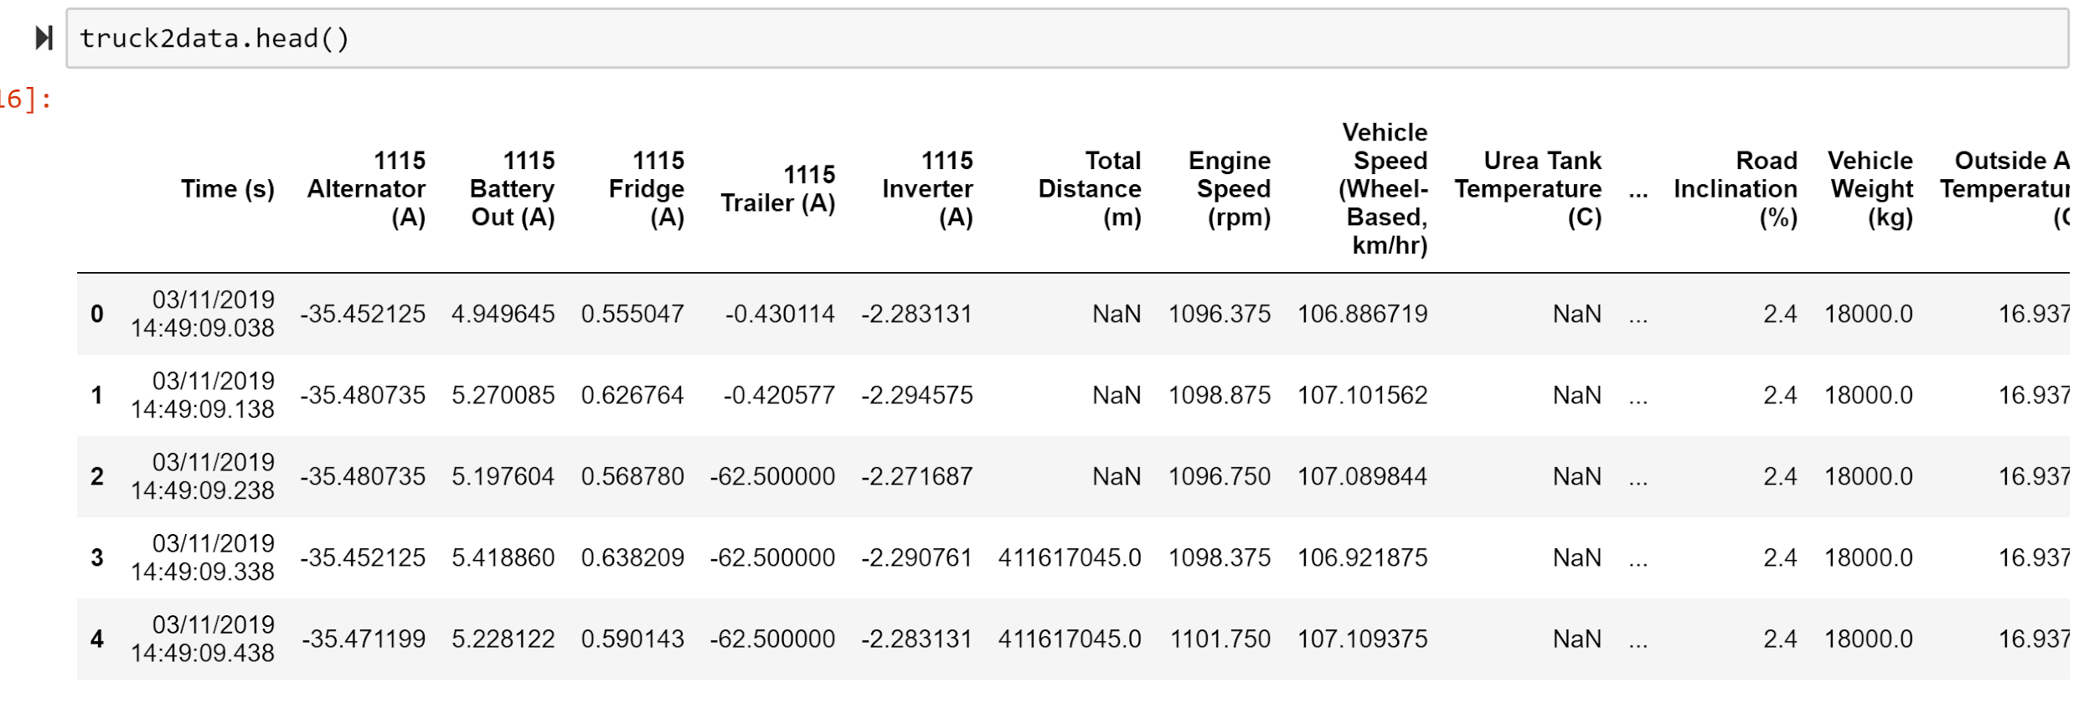
A few rows of the Raw Data (Truck 2)
Channel designations have been removed

Slide 4
Initial Goals (phase 1)
Clean the data
Replace channel designations with readable column names .
Gain insight from the data dictionary on what may or may not be included in our analysis.
Discover erroneos rows or columns with all NaN values and remove them.
Update git/test git on branching.
Initiate time series objects so later aggregation can be made easier.

Slide 5
Phase 1 Progress on tasks
Bill: Determine vehicle travel designation and update ReadMe.md on git.
Chris: Adjust and format the data dictionary to metrics being used.
James: Setup master branch with both data sets for manipulations and determine git functions on merging branches.
Wahab: Determine whether there are rows or columns with all NaN values, if so remove them.
Yanni: Merge weights together to determine how weight affects performance of the vehicles.

Slide 6
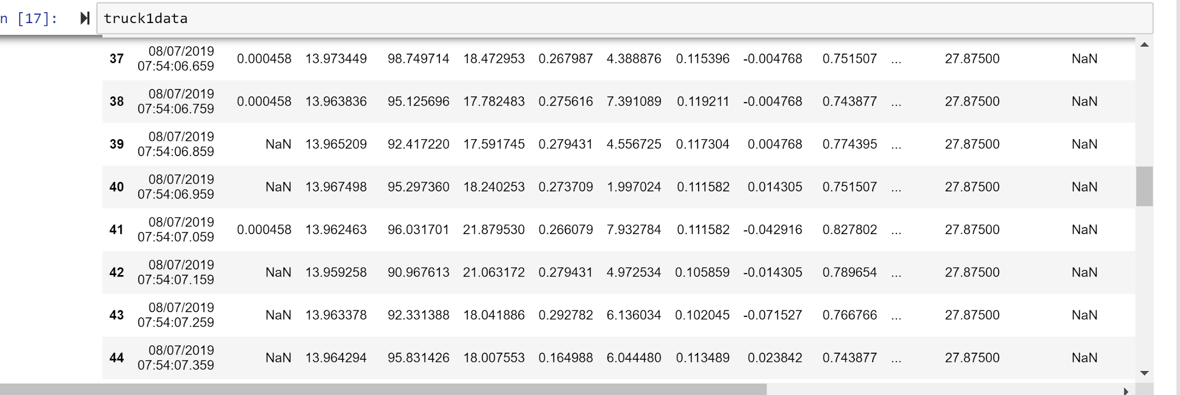
Occasional NaN description
The occasional NaN value occurs sometimes if a sensor is faulty or turns off/on at certain periods. Columns that contain all NaN values may be hidden customer data that is irrelevant to our needs.

Slide 7
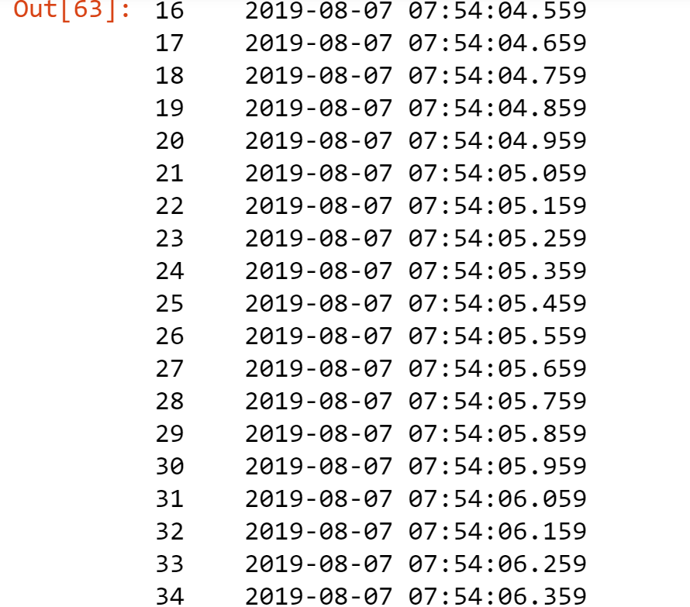
10Hz logging

Slide 8
Next Steps: More Analysis and Stats
Our group(4 undergrad and 1 graduate student) will be split up into two team members per truck and one “float” person for util and reporting .

